Slide 1
Great Theorem: The Solution of the Cubic
Cardano
Journey Through Genius Pp 142

Slide 2
Notes on the Argument
Upon examining Chapter XI of Ars Magna the modern reader has two surprises
First, Cardano did not give a general proof, but a specific example, although we will look at the general equation
Second, the proof was purely geometric and involved literal cubes and their volumes, but given the state of primitive symbolic algebra, and the “exalted position” of Greek geometry amongst the Renaissance mathematicians
The key result of Chapter XI is stated here, and although it may look quite confusing at a first glance, when looked at using an algebraic focus, it clearly does the job

Slide 3
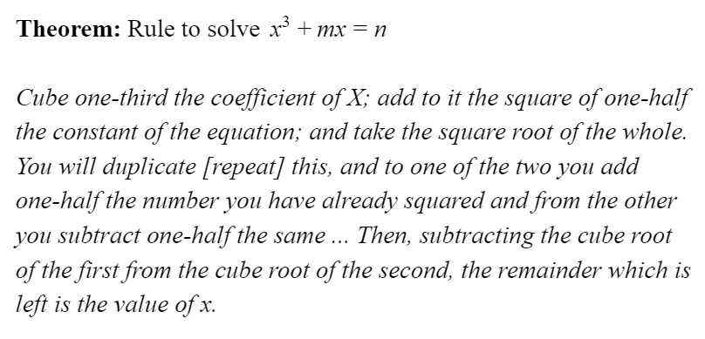
In Cardano’s own words

Slide 4
We will now examine the proof in the style of Cardano.

Slide 5
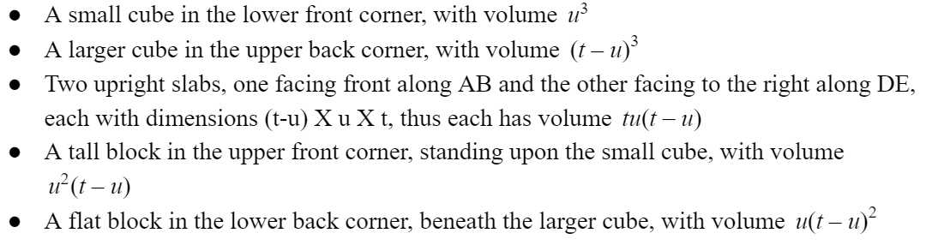
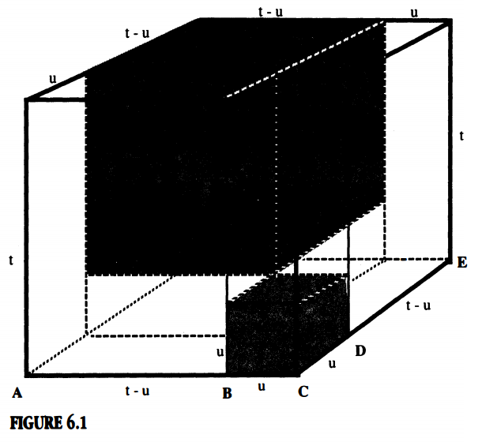
Cardano started with a cube, and cleverly divided the cube into six pieces, whose volumes are above

Slide 6
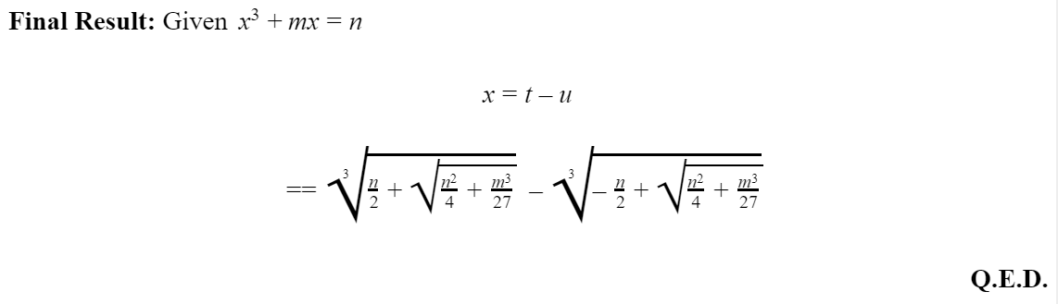
This proof is algebra heavy, and gets convoluted, so here is the final result.

Slide 7
Next:
A concrete example of Cardano’s solution
How can we “depress” these equations?
- let’s look at depressing a quadratic

